Slide 1
Statistics for Data Science

Slide 2
Descriptive Statistics

Slide 3
Statistics
Statistics is the process of collecting, organizing and interpreting data
Statistics is a set of mathematical methods and techniques specially adapted for collection, classification, analysis of data about objects of interest so as to draw meaningful conclusions and actionable recommendations to influence their behaviour or derive some advantage thereof.
Business Applications:
Finance
Marketing
Production
Human Resource

Slide 4
Statistics
Descriptive Statistics: Transformation of raw data to information.
Exploratory Data Analysis, Summarization and data visualization, presentation, profiling.
Example: Comparison of mean performances, Variance analysis
Inferential Statistics: Projection of data character from sample to population.
Point estimation, Interval estimation, Hypothesis testing
Example: Computing average household income
Sample
Data
Population
1. Produce Data
2. Exploratory Data Analysis
(EDA)
3. Inference
Probability

Slide 5
Data
Data are plain facts that has been gathered and available in plenty over years. It can be any character, including text and numbers, pictures, sound, or video.
Population: A population includes all elements of interest.
Sample Data: A sample consists of a subset of observations from a population. As a result, multiple samples can be drawn from the same population.
All the statistical analysis (formula, notation, etc.) depends on whether you are analysing a population or sample.

Slide 6
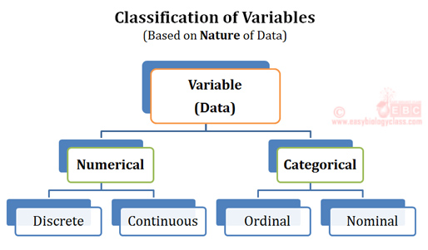
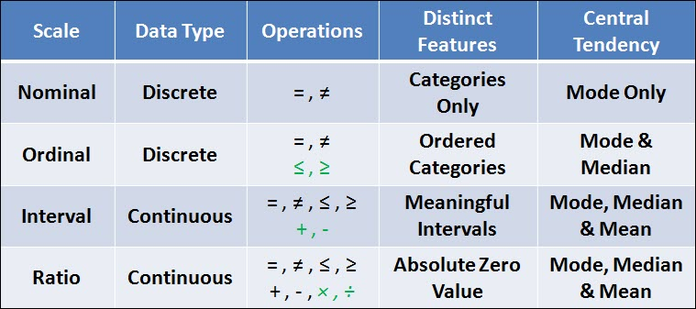
Data Types
Categorical - gender, marital status, hometown. These are just grouped data
Nominal – named variable . Eg. Name, city, place
Ordinal – It is also called as ordered data
How happy are you with your manager :
good - 4 , better - 6, best -2 , variability is there but distance cannot be measured
Numerical - person’s height, weight, IQ, or blood pressure
Discrete - number of heads in 100 coin flips takes on values from 0 through 100 (finite case). No in between values.
Interval : Interval measurement , distance between will be meaningful. Eg. The difference between a temperature of 100 degrees and 90 degrees is the same difference as between 90 degrees and 80 degrees.
Ratio : exactly the same as the interval scale except that the zero on the scale means: does not exist. Eg.a weight of zero doesn’t exist; an age of zero doesn’t exist. On the other hand, temperature is not a ratio scale, because zero exists
Continuous - values that have incremental in between. Eg. Measure of blood sugar, height, how much liters of water a person drinks

Slide 7
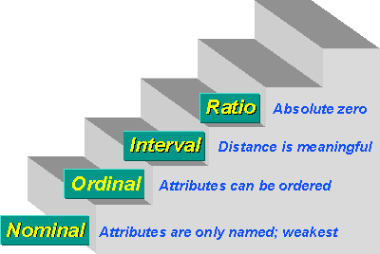
Measurement scale
Nominal | Can be divided to categories. Categories are labeled | Gender Part No
Ordinal | Can be ranked. | Low, Med, High
Interval | Difference can be measured | Temperature
Ratio | All arithmetic is possible | Sales, Height, Age

Slide 8
To Summarize
Statistics | The art and science of collecting, analyzing, presenting and interpreting data
Data | Facts and figures as they exist or as they are collected for further processing
Data Set | All the data collected and recorded
Elements | The entities on which data is collected
Variable | A characteristic of interest of the element
Observation | The set of measurements of variables of single element
Nominal Scale | Non numeric or coded data used for labels and names without order
Ordinal Scale | A nominal measurement which can be ordered or ranked
Interval Scale | Ordinal data in which distance between points is meaningful.
Ratio Scale | Interval data upon which all arithmetic operations are meaning full
Qualitative | Data used for labeling. Either nominal or Ordinal
Quantitative | Data in numeric form indicating how much how many of things
Cross Section | All data collected at a particular instance of time
Time series | Data Collected over a period of time or at different points of time

Slide 9
Variable
A variable is an attribute that can be used to describe a person, place, or thing.
TYPES OF DATA:
CATEGORICAL DATA: The value indicates group membership. Example: Gender, Age group, Rank, Rating, Educational degree.
Nominal: Can be divided to categories. Categories are labelled. Example: Gender (M/F), Colors
Ordinal: Can be ranked. Example: Low, Medium, High; Ranks, Ratings
QUANTITATIVE / NUMERICAL DATA: The value has numerical meaning. Example: Age, Height, Sales, Revenue
Interval: Difference can be measured.
Ratio: All arithmetic is possible. Example: Sales, Height, Age
Discrete variables: Take on a specific value and must be an integer. Example: Number of vehicles, Number of people
Continuous variables: Can take on any value within a range. Example: Temperature, Weight
CROSS SECTIONAL DATA: All data collected at a particular instance of time. Example: Share value of 20 companies on a particular day
TIME SERIES DATA: Data Collected over a period of time or at different points of time. Example: Sales data collected over 5 years

Slide 10
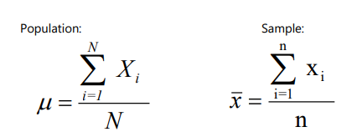
Measures of Central Tendency (Location)
Central tendency measures simply provide information on the most typical values in the data for a given variable.
Mean: The mean represents the average value of the variable. It can be calculated as:
Median: The median is the middle most value in an ordered set. To calculate the median in an ordered set and the middle most value can be found using: Md= (n+1)/2 for odd number of observations and for even number of observations, the median is the average of the value above and below this location
Mode: The mode is the value that occurs with greatest frequency. Used for qualitative data. Multiple modes are poor discriminators

Slide 11
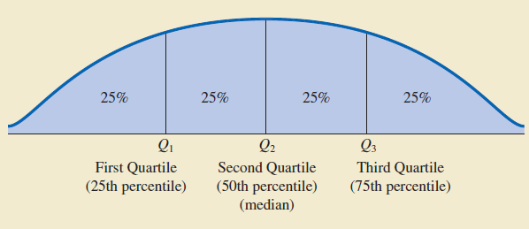
Measures of Central Tendency (Location)
QUARTILES:
It is often desirable to divide data into four parts, with each part containing approximately one-fourth, or 25% of the observations. The division points are referred to as the quartiles
Q1 = first quartile, or 25th percentile → i = n/4
Q2 = second quartile, or 50th percentile (also the median) → i = n/2
Q3 = third quartile, or 75th percentile → i = 3n/4

Slide 12
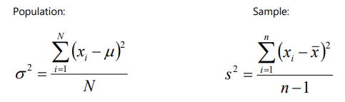
Measures of Variability (Spread)
Measures of Variability are used to better understand the shape of a variable’s distribution
Range: Range is the minimum value subtracted from the maximum value. It is highly influenced by extreme values, or rather it is influenced only by extreme values.
Range = Max (i) – Min (i)
Variance: The variance measures the dispersion of the data from the mean. Useful in comparing the variability of two variables
Standard Deviation: The standard deviation is the square root of the variance (to return the measure to the same scale as mean). SD indicates how close the data is to the mean (average distance between every data value and the mean).

Slide 13

Measures of Variability (Spread)
Interquartile Range (IQR): This measure of variability is the difference between the third quartile, Q3, and the first quartile, Q1. IQR is the range for the middle 50% of the data. A measure of variability that overcomes the dependency on extreme values. Can be used to detect outliers.
Standard Error: Standard error indicates how close sample mean is from true population mean. SE indicates the reliability of the mean that we obtained.
Coefficient of Variation: It is a descriptive statistic that indicates how large the standard deviation is relative to the mean, usually represented as percentage.
Coefficient of Variation = (Standard deviation/Mean)*100 %
In general, the coefficient of variation is a useful statistic for comparing the variability of variables that have different standard deviations and different means.

Slide 14
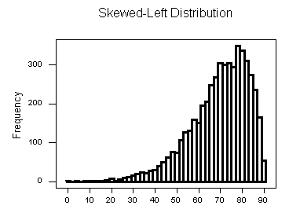
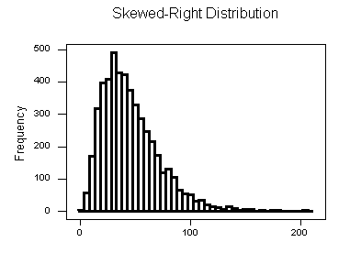
Measures of shape of a distribution
Skewness: Indicates asymmetry in the distribution
Data skewed to the left:
Skewness is negative | Mean < Median
Data skewed to the right:
Skewness is positive | Mean > Median
If the data are symmetric
Skewness is zero | Mean = Median
The median provides the preferred measure of location when the data are highly skewed, since median is unaffected by large values or outliers

Slide 15

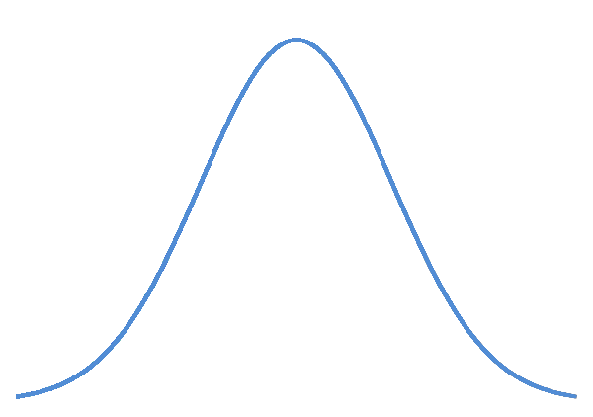
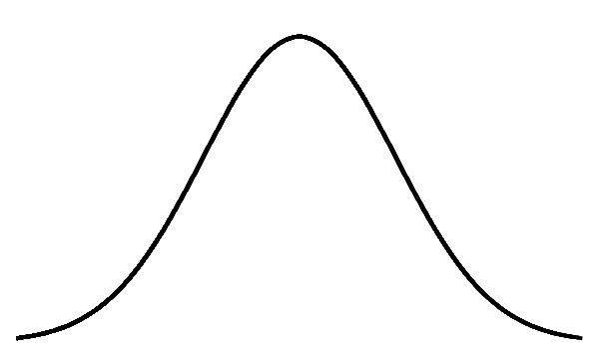
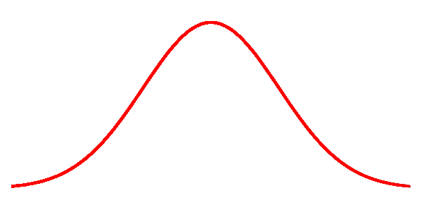
Measures of shape of a distribution
Kurtosis: Indicates peakness of the distribution
Positive values indicate light tails
Negative value indicate heavy tails
Normal distribution has a kurtosis of zero
Leptokurtic
Normal
Platykurtic

Slide 16
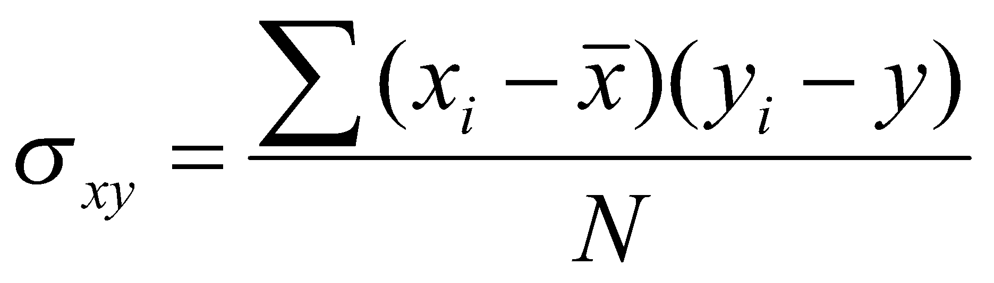
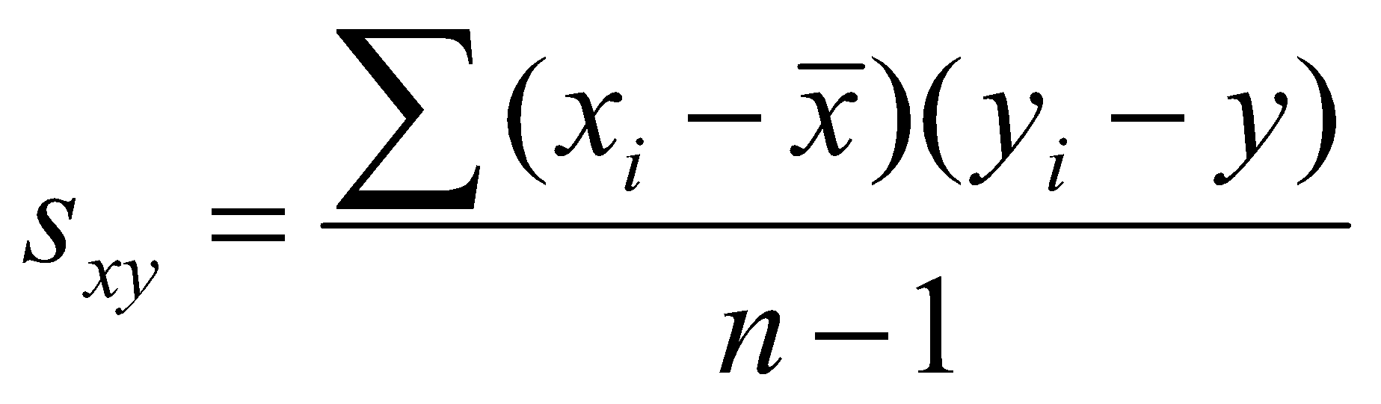

Measures of Measures of Association Between Two Variables
COVARIANCE
Covariance as a descriptive measure of the strength of linear association between two variables
A positive value for Sxy: Positive linear association between x and y
A negative value for Sxy: Negative linear association between x and y
For Sxy close to zero, it indicates no linear association between x and y
CORRELATIONS
Correlations measure the strength of the relationship, or association, between two variables. The sample’s correlation coefficient is denoted by r, while the population correlation is denoted by ρ or R
Perfect positive linear relationship → Correlation coefficient = +1
Perfect negative linear relationship → Correlation coefficient = -1
A value of rxy equal to zero indicates no linear relationship between x and y

Slide 17
Descriptive Statistics
Descriptive Statistics
Mean
Standard Error
Median
Mode
Standard Deviation
Sample Variance
Kurtosis
Skewness
Range
Minimum
Maximum
Sum
Count
Confidence Level (95.0%)
Generate random numbers
Enable Analytics ToolPak in Excel
Data → Data Analytics → Descriptive Statistics
Read and analyse the results

Slide 18
Thank You

